Slide 1
Behavior Driven Development with Cucumber JAVA
Ankit Singh Kushwah

Slide 2
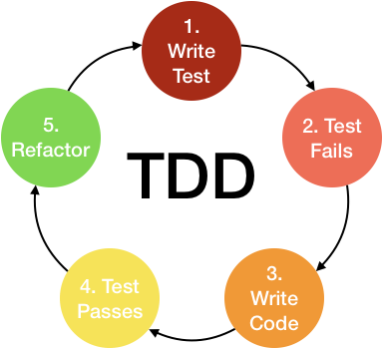
Test Driven Development

Slide 3
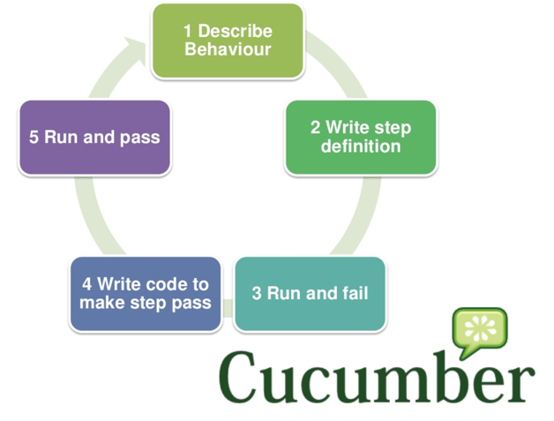
Behavior Driven Development

Slide 4
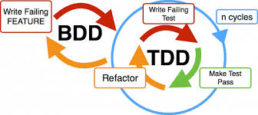
BDD with TDD

Slide 5

Gradle Dependency
Configure build.gradle to include cucumber jar files in classpath.

Slide 6
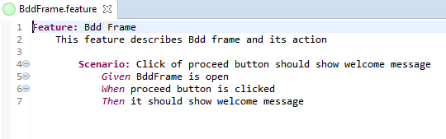
Feature File
BddFrame.feature

Slide 7
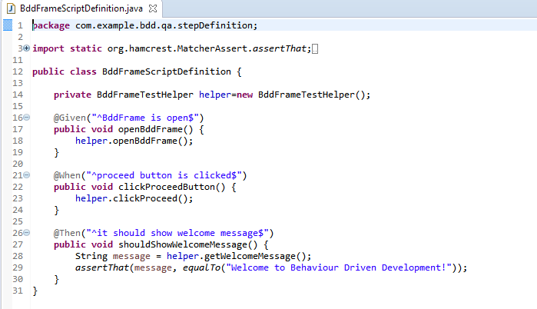
Step Definition

Slide 8
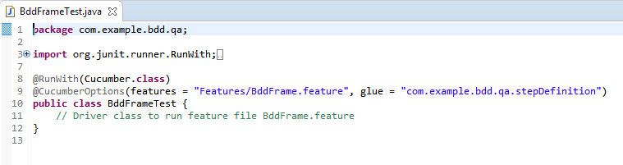
Test Runner
Can be executed directly by run as cucumber feature.

Slide 9
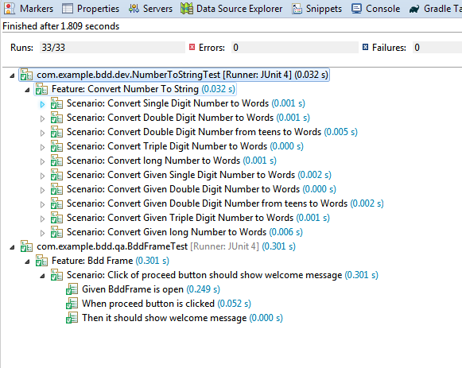
Test Execution

Slide 10
Questions?

Slide 11
Thank You!!!

